Slide 1
Python Programming CENG342
Assist.Prof.Dr.Murat ŞİMŞEK

Slide 2
Context
Variables and Simple Data Types
Introducing Lists
Working with Lists
if Statements
Dictionaries
User Input and while Loops
Functions
Classes /Object Oriented Programming
Files and Exceptions
Project

Slide 3
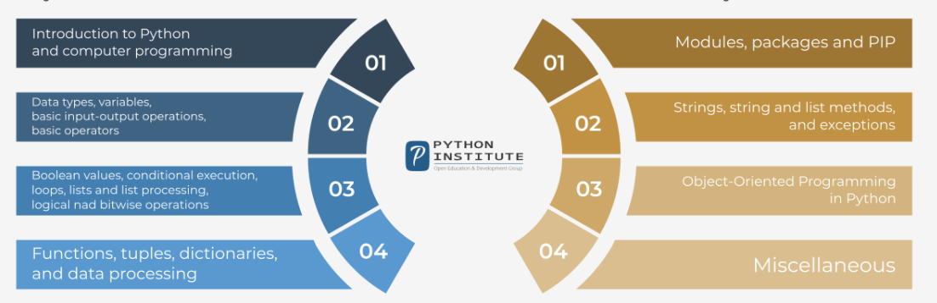
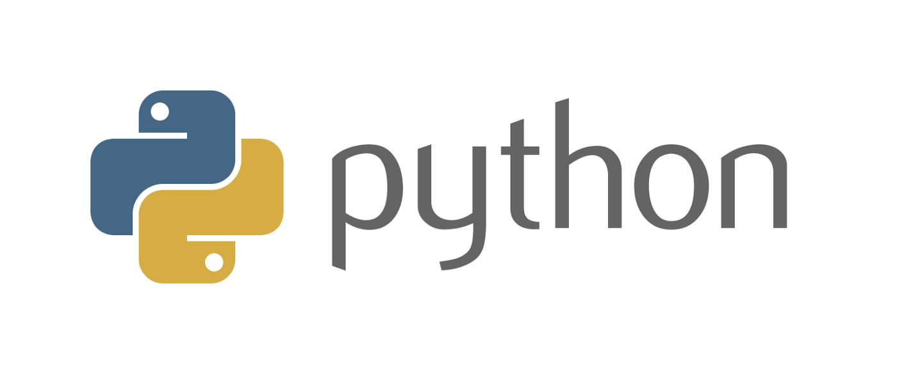
Python Programming

Slide 4
Python Programming
Python is a widely-used, interpreted, object-oriented, and high-level programming language with dynamic semantics, used for general-purpose programming.

Slide 5
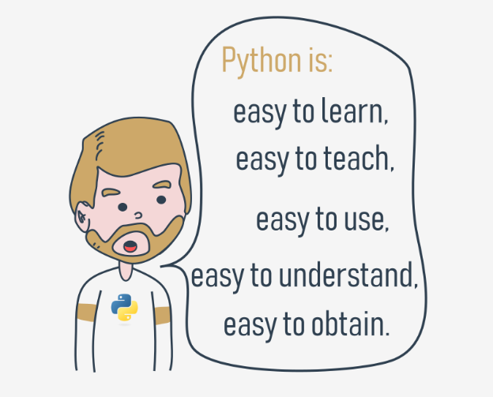
Python Programming

Slide 6
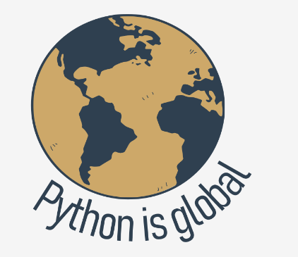
Python Programming

Slide 7
Python Programming
Contribution
Mid-term Exam %40
Final Exam %60

Slide 8
Python Programming
practice
Practice
Practice
Practice
Practice
Practice
Practice
Practice
Practice

